Slide 1

Data Science & Backend Track

Slide 2

Presentation Overview
Motivation
What does a Backend Developer do?
What does a Data Scientist do?
How does our track work?
How will we work together?
Resources and References

Slide 3

Motivation

Slide 4
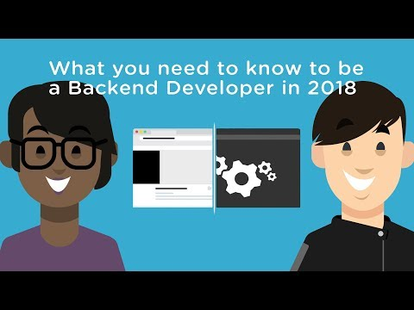
What does a Backend Developer do?

Slide 5
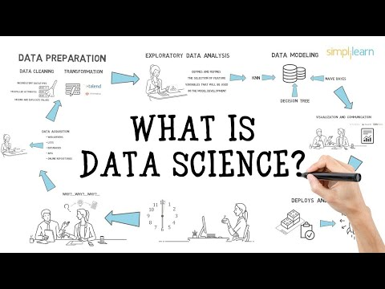
What does a Data Scientist do?

Slide 6


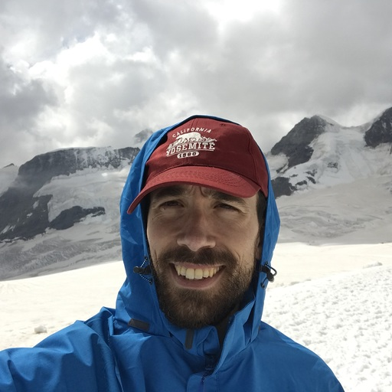
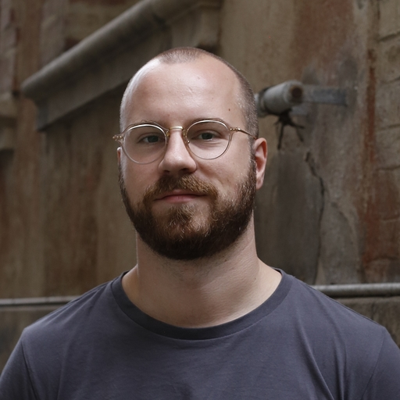
Our stories
Ana
Dominik
Eduardo
Johannes

Slide 7

How does our track work?

Slide 8

Course Organization - Layout
Guided Self Study
Introduction week
Python Programing
SQL
Machine Learning
Data visualization
Focus Projects
Option A: Data Science Project
Option B: Web Application
Notes:
We provide:
Pointers to good online tutorials/ressources
Guidance on “how to find solutions to problems”
Daily (minimum) hour to answer questions
You should:
Learn new technologies with online ressources
Make an awesome project

Slide 9




Course Organization - Introduction Week
Databases
Data Visualization
Machine Learning
Notes:
4 days for primers in the first week

Slide 10



Course Organization - Focus Projects
Web Application with Backend in Python
Machine Learning Project in Jupyter
Notes:
Two projects in the following weeks
We provide skeleton, you can fill out
The projects are supposed to be open, depending on the individual level of participants
We provide guidance if someone gets stuck

Slide 11

Web Application Project
Notes:
4 days for primers in the first week

Slide 12
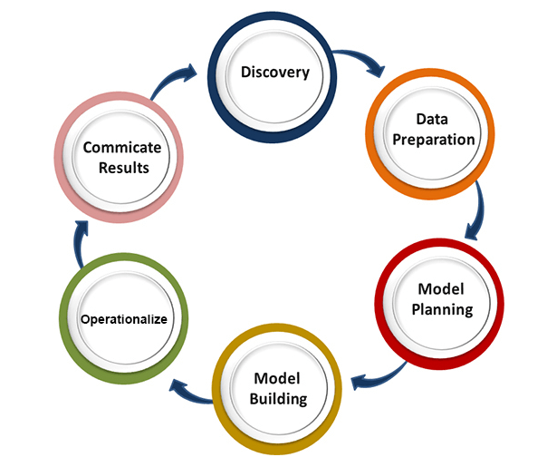
Machine Learning Project
Notes:
4 days for primers in the first week

Slide 13

How will we work together?

Slide 14


You:
Learn new technologies using online resources
Make an awesome project
Notes:
We provide:
Pointers to good online tutorials/ressources
Guidance on “how to find solutions to problems”
Daily (minimum) hour to answer questions
You should:
Learn new technologies with online ressources
Make an awesome project

Slide 15





We:
Provide pointers to good online tutorials/resources
Provide daily support:
“how to find solutions to problems”
answer questions
Notes:
We provide:
Pointers to good online tutorials/ressources
Guidance on “how to find solutions to problems”
Daily (minimum) hour to answer questions
You should:
Learn new technologies with online ressources
Make an awesome project

Slide 16

Resources and References
All resources and information will be posted at:
https://github.com/Powercoders-ZRH/data_science-backend-track
Slack channel for questions and communication: #data_science-backend-track

Slide 17

Questions?
Notes:
4 days for primers in the first week

Slide 18

We hope to see you in our track
Notes:
4 days for primers in the first week

